Slide 1
Signal Propagation Basics
K. Ramizuddin, ACET/ETC
5th Sem A-AWP

Slide 2
Propagation Modes
Ground-wave (< 2MHz) propagation
Sky-wave (2 – 30 MHz) propagation
Line-of-sight (> 30 MHz) propagation

Slide 3
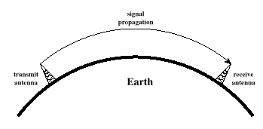
Ground Wave Propagation

Slide 4
Ground Wave Propagation
Follows the contour of the earth
Can propagate considerable distances
Frequencies up to 2 MHz
Example
AM radio
submarine communication (long waves)

Slide 5
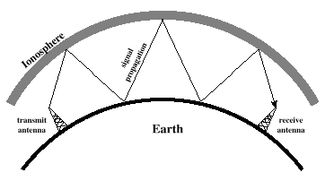
Sky Wave Propagation

Slide 6
Sky Wave Propagation
Signal reflected from ionized layer of atmosphere back down to earth
Signal can travel a number of hops, back and forth between ionosphere and the earth surface
Reflection effect caused by refraction
Examples
amateur radio
International broadcasts

Slide 7
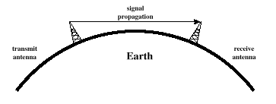
Line-of-Sight Propagation

Slide 8
Line-of-Sight Propagation
Transmitting and receiving antennas must be within line of sight
Satellite communication – signal above 30 MHz not reflected by ionosphere
Ground communication – antennas within effective line of sight due to refraction
Refraction – bending of microwaves by the atmosphere
Velocity of an electromagnetic wave is a function of the density of the medium
When wave changes medium, speed changes
Wave bends at the boundary between mediums
Mobile phone systems, satellite systems, cordless phones, etc.

